Slide 1
Connecting Science and Veterans Day
ASTA - Arkansas Science Teachers Association

Slide 2
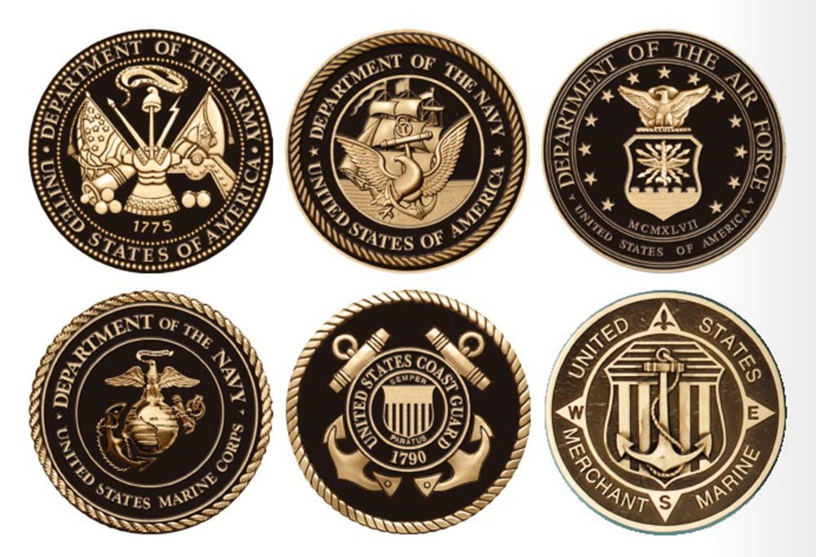
Honoring Those Who Have Served
We all have loved ones who served in the military.
How can we learn from their sacrifices to make our pursuit of science education more meaningful to students in the future?

Slide 3
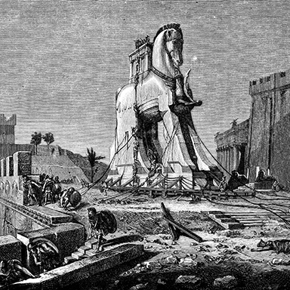
The Science of Camouflage
Historical accounts of great military deceptions are legion. Among the best known is the Trojan Horse gambit. You remember it (even though it happened centuries before you were born): ancient Greece was at war with the walled city-state of Troy. For 10 years, the Greeks laid siege to easily defended Troy and were stalemated at every turn.
Tired of this, the Greeks eventually came up with a sneaky scheme to penetrate the heavily fortified walls and overthrow the city. Step One, the Greeks pulled back as if to say “We quit.” Step Two, the apparently withdrawing Greeks then left behind a giant wooden horse on wheels to honor the city’s heroic defenders. The Trojans cheered as the “gift” was wheeled inside the gates, unaware that concealed within the belly of the beast was a squad of elite Greek commandos.
That night, after the city was fast asleep, the commandos cracked the secret hatch built into the horse and slipped out to begin stealthily making their way to Troy’s gates. Upon reaching their objective, the squad opened the gates to allow a waiting phalanx of Greek archers, charioteers, and assorted foot soldiers to storm in and conquer the place (read about it in the literary classic Iliad and Odyssey, written in approximately 750 B.C.).
Trojan Horse-style deception was a concept discussed in The Art of War by ancient Chinese military strategist Sun Tzu. He enthusiastically endorsed it in the context of ways to secure victory despite being outnumbered by the enemy.
There are countless other citable examples of deception throughout military history. However, to get directly to the point, deception has been long recognised as an effective means of shifting the tide of battle.
Notes:
Greek - Trojan war
https://ufpro.com/gb/blog/military-camouflage

Slide 4
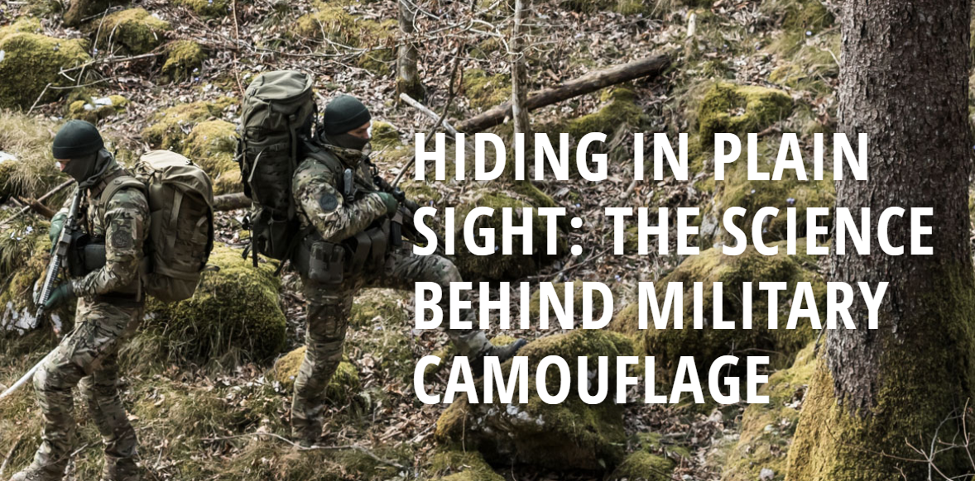
The Science of Camouflage
Goal: To explore the science behind camouflage and create a camouflage design demonstrating its effectiveness in different environments.
Activity: Start with a discussion about the science of camouflage and patterns to blend into surrounding. Then have students create their own pattern for a specific or selected environment.
There are various ways by which soldiers can disguise themselves to either avoid an encounter with hostile forces or gain over them the element of surprise. The least effective disguise is a fake mustache. But among the very most effective disguises is camouflage, the purpose of which is to make soldiers and equipment less visible to enemy eyes.
Notes:
https://docs.google.com/document/d/1YhhsFxfK8CIt9Q9dHSrual97ig1vbU5xKbckvwJT3g0/edit?usp=sharing

Slide 5
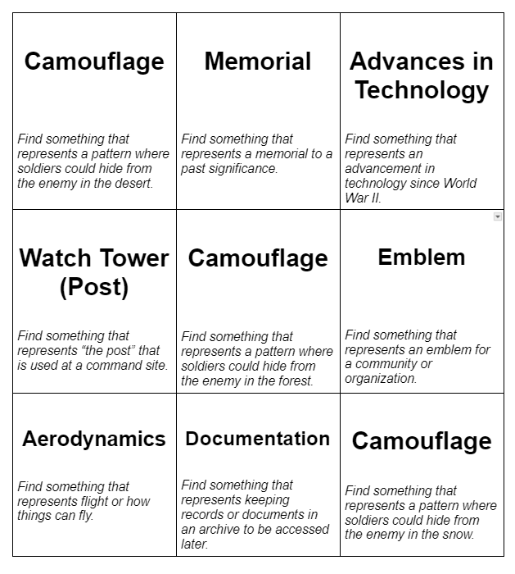
Bingo Activity
Students can use this to find things around your campus, classroom, or school that represent military activities, virtues, symbols, or science concepts.
Task: Take a picture of the representation and explain how or why this represents each.
Notes:
https://docs.google.com/document/d/19Q6zJqMSVe9leBPRD0xkXQJ-r7oVypRCp_7AkFV7zTA/edit?usp=sharing

